Slide 1
Topics in Computer and VLSI Project Group 9
Students:
LE VAN DUC Ali Almokhtar
2016-27885 2015-30846

Slide 2
Pre-Processing data
Removing missing values columns: >20% missing values columns (5 columns)
Impute missing values: < 20% missing values columns, fill by mean column value.
OneHotEncoding: for categorical features (MSZoning: RL/RM/FV -> 1,0,0/0,1,0/0,0,1)
The data is scale to range [0-1]

Slide 3
Regression ( Basic model )
Linear Neural Network:
1 Input Layer = 269 nodes.
1 Output Layer = 1 node.
Loss function: L(w) = ½ * (w.T * x - y)²
Gradient descent: w = w - learning_rate * gradient
= learning_rate * (w.T * x - y) * x)
Training with mini-batch: batch size = 100 examples,
learning rate = 0.0002,
number of iterations = 200 * 3000 = 60,000.
Predicted Value | Real Vlaue
164477 | 134000
157664 | 110000
185081 | 284000
132671 | 97000
146387 | 119000
185310 | 175500

Slide 4
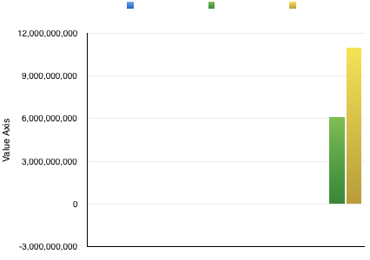
Regression ( Optimization model )
Use dimensional reduction by Sklearn PCA algorithm
Reduce dimension 269 -> 40.
Compare the result
Predicted Value | Real Value
152235 | 134000
147842 | 110000
171194 | 284000
108149 | 97000
133409 | 119000

Slide 5
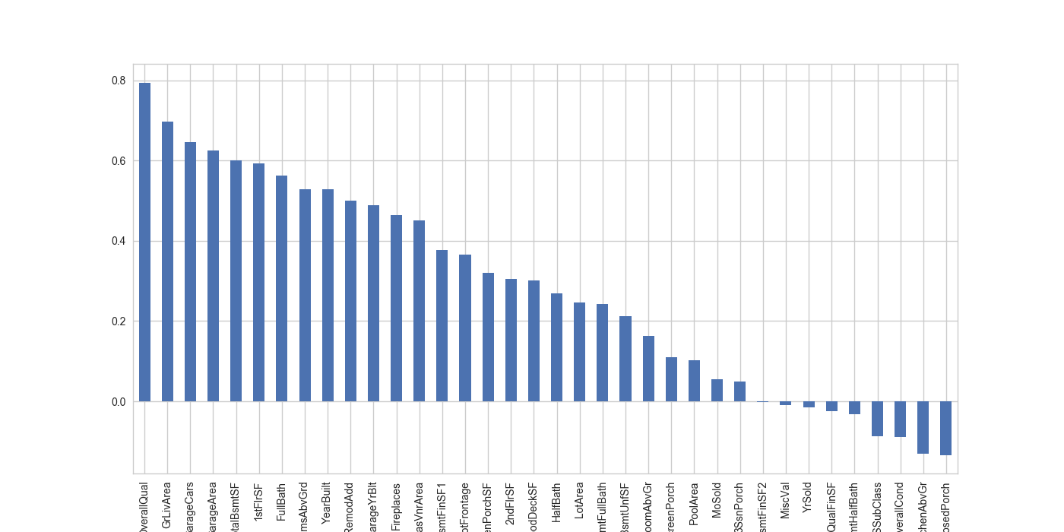
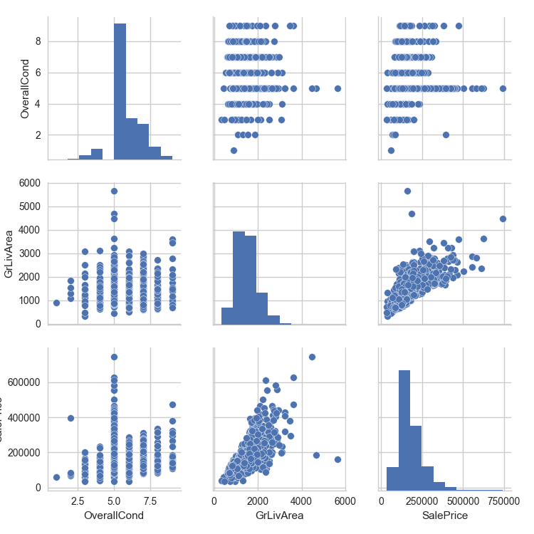
Variables are comparatively more related to the house price

Slide 6
Classification Model 1
Neural Networks: used efficiently in the classification problem.
Architecture:
Input layer: number = number of data features
Hidden layer: choose = 10
Output layer: 2 nodes = 2 output class.
Training: Back propagation algorithm. Learning rate = 0.001, mini-batch size = 100.
Cross-validation with 80/20 ratio.
In-sample error rate ~ 48.33%.

Slide 7
Classification 2
Logistic classification: simple algorithm with binary output.
Formula: exp(b0 + biXi) / [1.0 + exp(b0 + biXi)] b0 = bias, bi = learning coefficients
Stochastic Gradient Descent to train the model.
Gradient descent: delta = error * yhat * (1.0 - yhat) with error = (y - yhat), yhat = prediction made by the model, y = real target result.
b = b + learning_rate * delta. Learning_rate = 0.001
Cross-validation with 80/20 ratio.
In-sample error rate ~ 36.41%.

Slide 8
Improve the performance of one model
Dimensional reduction to avoid the overfitting.
269 -> 40.
Use Cross-validation selection to choose best dimension.
Change hidden layer number to change the capacity of the Neural Networks model.
Change hidden layer number from 10 -> 50, step = 10.
Use Cross-validation selection to choose best number with highest validation accuracy.
The best hidden layer number = 40.
Better in-sample error rate ~ 23%.

Slide 9
Q&A

